Slide 1
Efficient Robot Fabrication
Gary Pierson- Coach 1764
Chase Hill- COO 1764

Slide 2
Course Overview
Material Basics
COTS (Components off the shelf)
Suppliers
Efficient shaping/machining

Slide 3
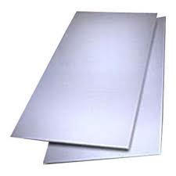
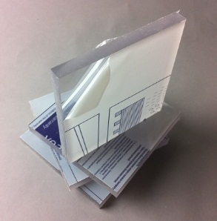
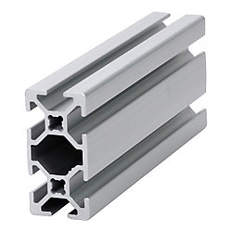
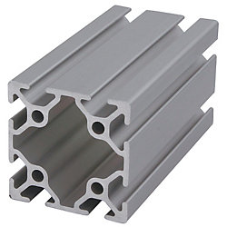
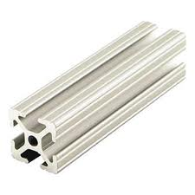
Types of materials
Sheet materials
Metals
Plastics
Extrusions
80/20
Bosch

Slide 4
Types of materials (Cont.)
Shaft Materials
Hot Pressed
Cold Pressed
Drill Rod

Slide 5

Suppliers
High-tech Automation

Slide 6
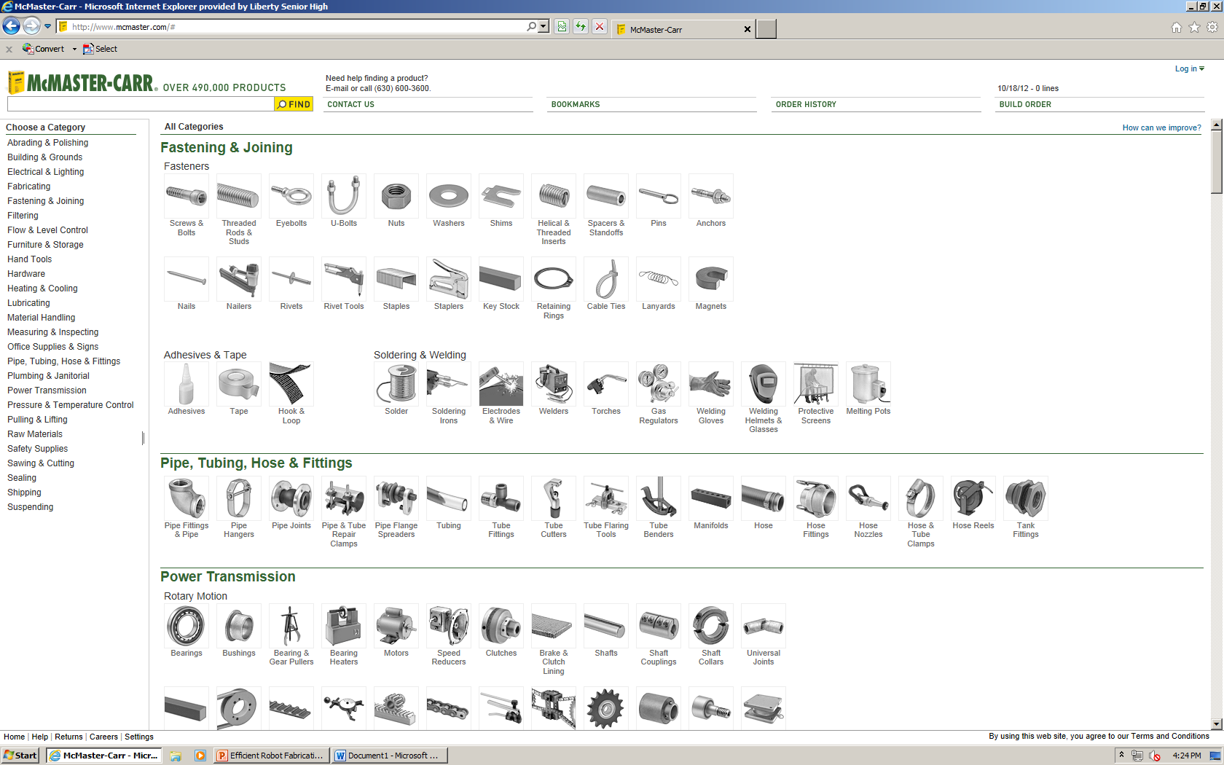
Suppliers (Cont.)
McMaster Carr

Slide 7
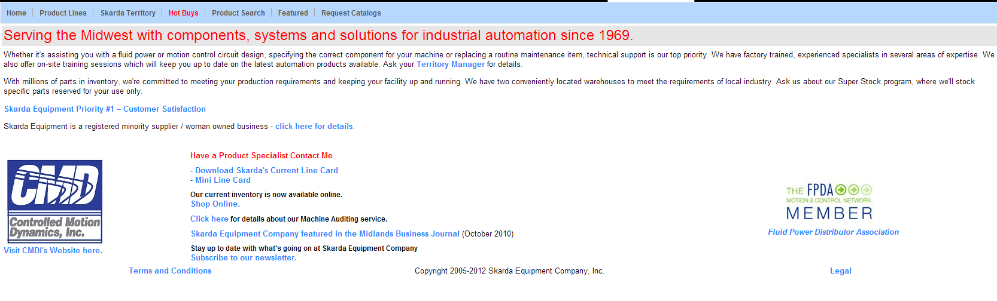
Suppliers (Cont.)
Skarda

Slide 8
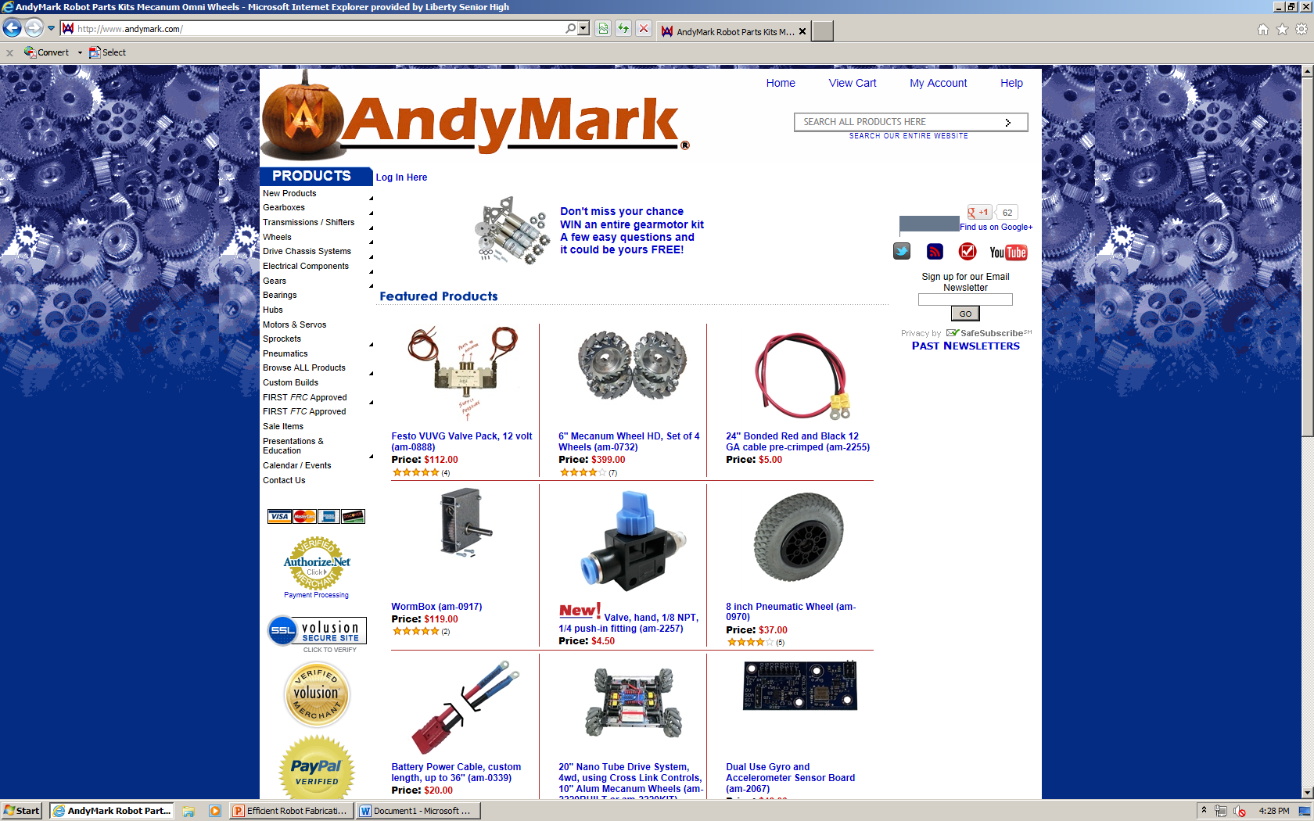
Suppliers (Cont.)
Andy Mark

Slide 9
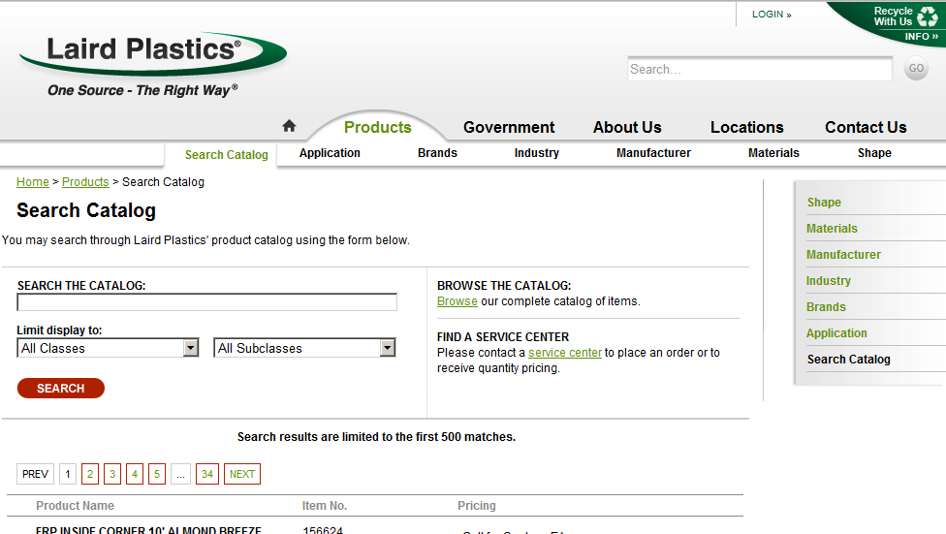
Suppliers (Cont.)
Laird Plastics

Slide 10
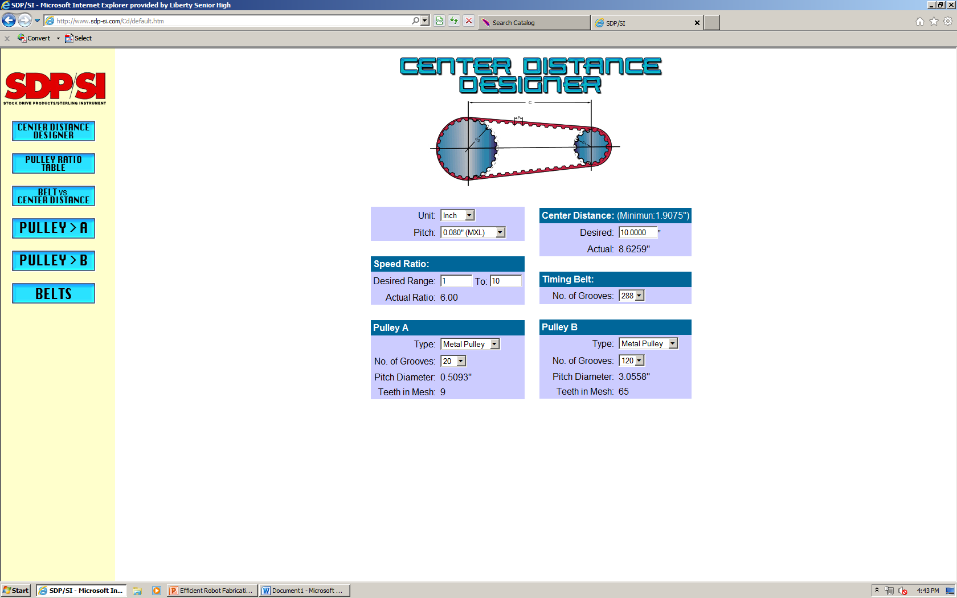
Suppliers (Cont.)
Stock Drive Product and Sterling Instrument (SDP/SI)

Slide 11
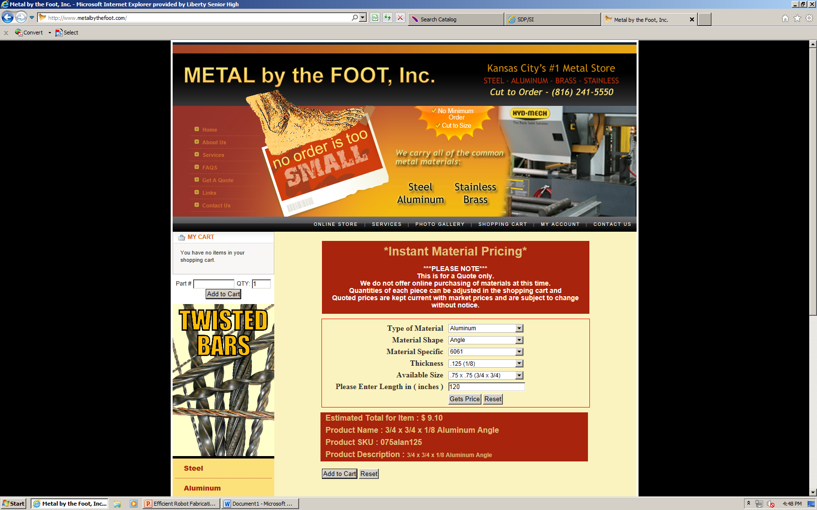
Suppliers (Cont.)
Metal-By-The-Foot

Slide 12
Types of Machining
Drilling
Cutting
Bending

Slide 13
Tools Needed
Marker or drawing utensil
Punches
Ball Peen Hammer
Combination Square
Dial Calipers
Correct Size Drills (sometimes smaller bits)

Slide 14
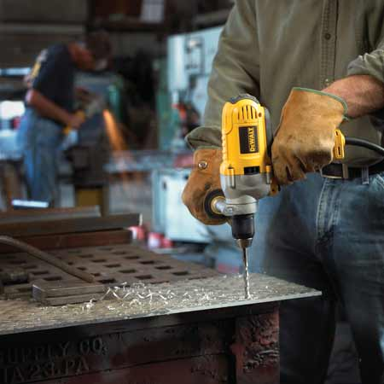
How To Drill Precise Hole Locations
Know where your hole is
Measure and mark it
Measure it again
Center Punch
Drill pilot hole if needed
Drill with a full sized bit
Debur the hole

Slide 15
Drilling Tips and Tricks
Use a punch
Above ¼ in, drill starter hole
Oscillating pressure with hole saws

Slide 16
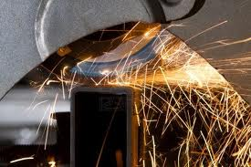
Cutting tips and tricks
Start with strips of smallest dimension
Keep leftover strip if still big enough to be useful
Irregular parts, use CAD
On some tools allow space for the blade

Slide 17
Cutting Tips and tricks (cont.)
Shaft
Add 1/8th inch to wanted length
Turn as you cut
File edge to a chamfer

Slide 18
Cutting Tips and tricks (cont.)
Extrusion
Do not add 1/8th
Hand File sharp edges
Avoid chamfer

Slide 19
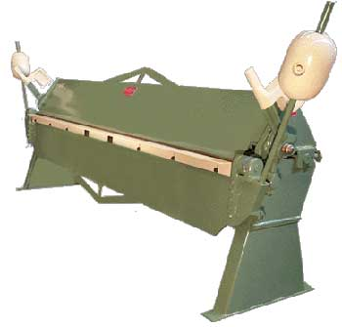
Bending Tips and Tricks
Draw Bend Line
Compensate for bend radius
Make jig if needed
Over bend for elastic materials

Slide 20
Bending Tips and Tricks (Cont.)
Other tools you can use
Vise
Wood board
Hammer

Slide 21
Fasteners
Nuts and Bolts
Screws
Adhesives

Slide 22
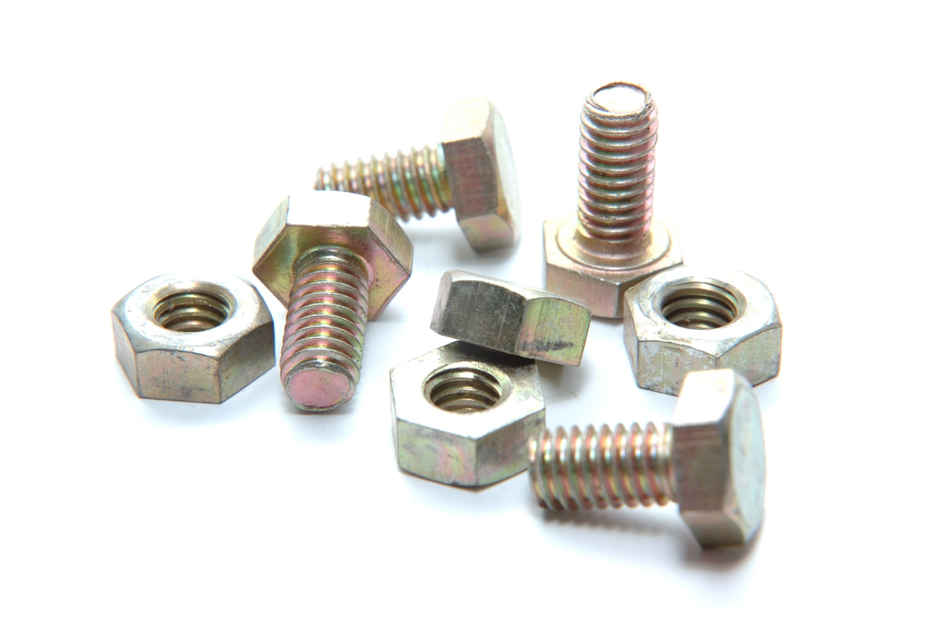
Nuts and Bolts
Nuts
Come in different shapes to suit different purposes
Lock nut
T-nut
Bolts
Come in a multiple sizes and heads

Slide 23
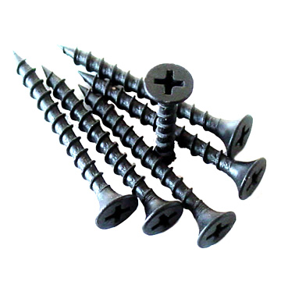
Screws
Most of the time used with wood
Can be done with metal
Bolt and Screw can be used interchangeably only difference is in application

Slide 24
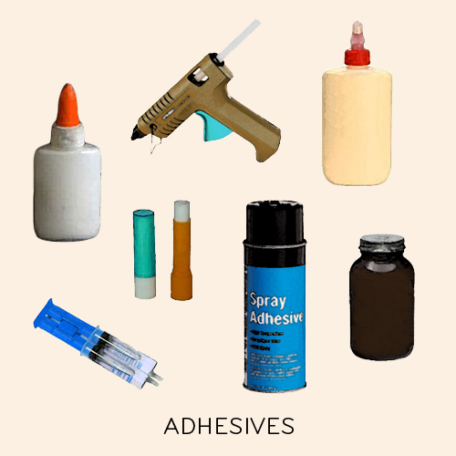
Adhesive
Many different types and specs
Tape
Epoxy
Glue

